Slide 1

Introduction
Name: Hari Ahir
Qualification: B.com
Project details: Fitness and Health management application
Guided by: shabnam ma’am

Slide 2
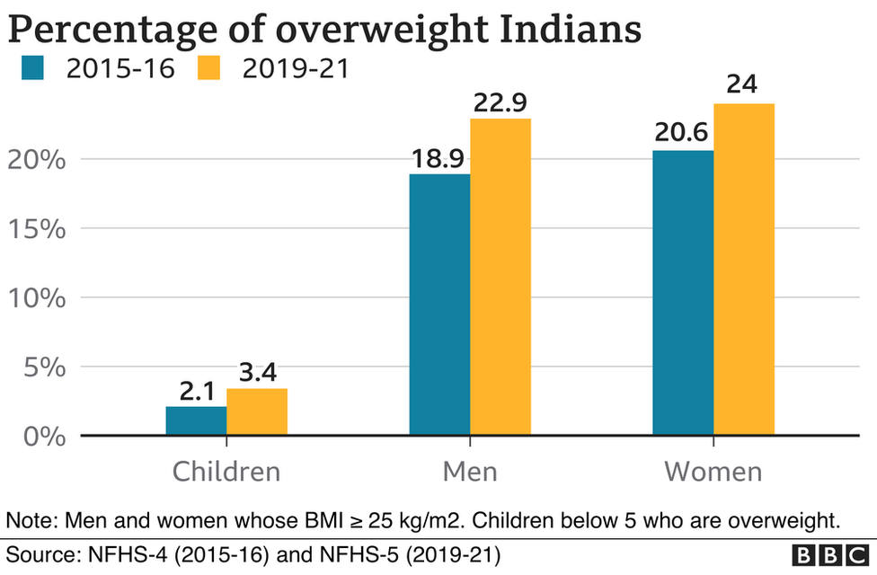

Slide 3

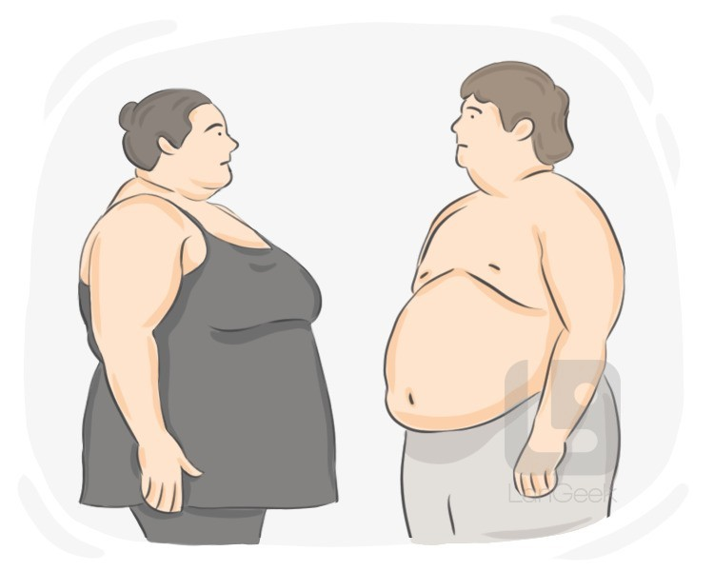
Common Risk Related to Obesity
Type 2 diabetes
Heart disease
Stroke
Sleep apnea
High blood pressure
Liver disease
Gallbladder disease
Certain cancers
Pregnancy complications
Depression

Slide 4

BMI
Your BMI is an indirect measure of your body composition — or how much body fat you have. Although BMI doesn't measure body fat directly, it uses a ratio of your weight and height and results in one of the following classifications: underweight, normal weight, overweight or obesity.

Slide 5
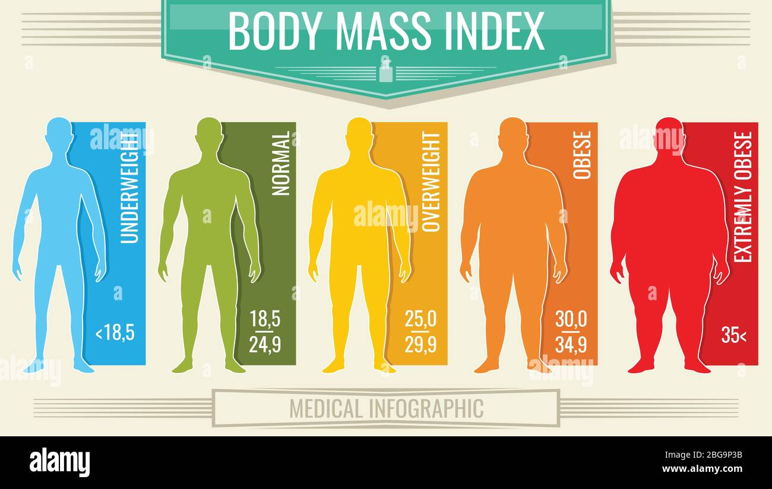

Slide 6
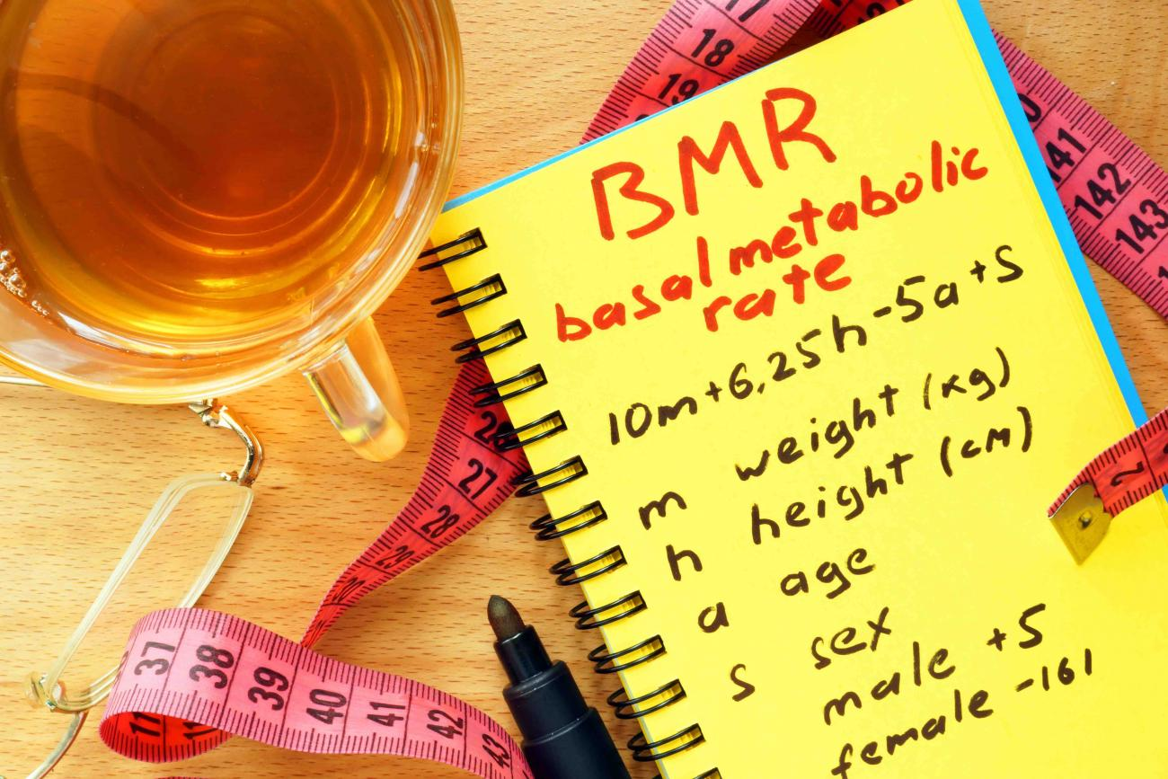

Slide 7
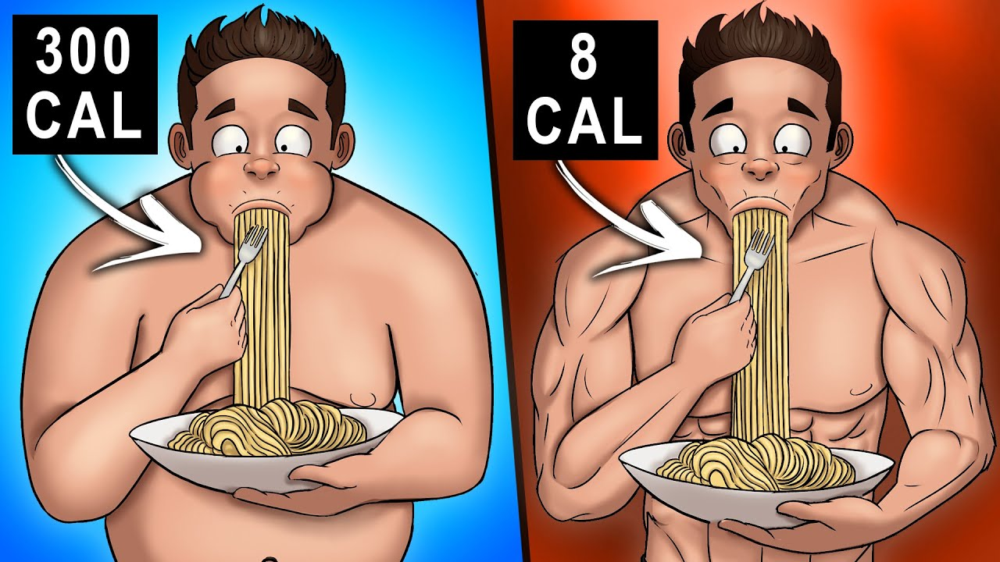

Slide 8

How many calories should you eat on average?
The number of calories from carb,protine and fat you should eat per day depends on numerous factors, including your age, sex, height, current weight, activity level, and metabolic health, among several others.
When trying to lose weight, it’s important to create a calorie deficit by consuming fewer calories than you normally do or by exercising more.and for weight gain eat more calories.

Slide 9
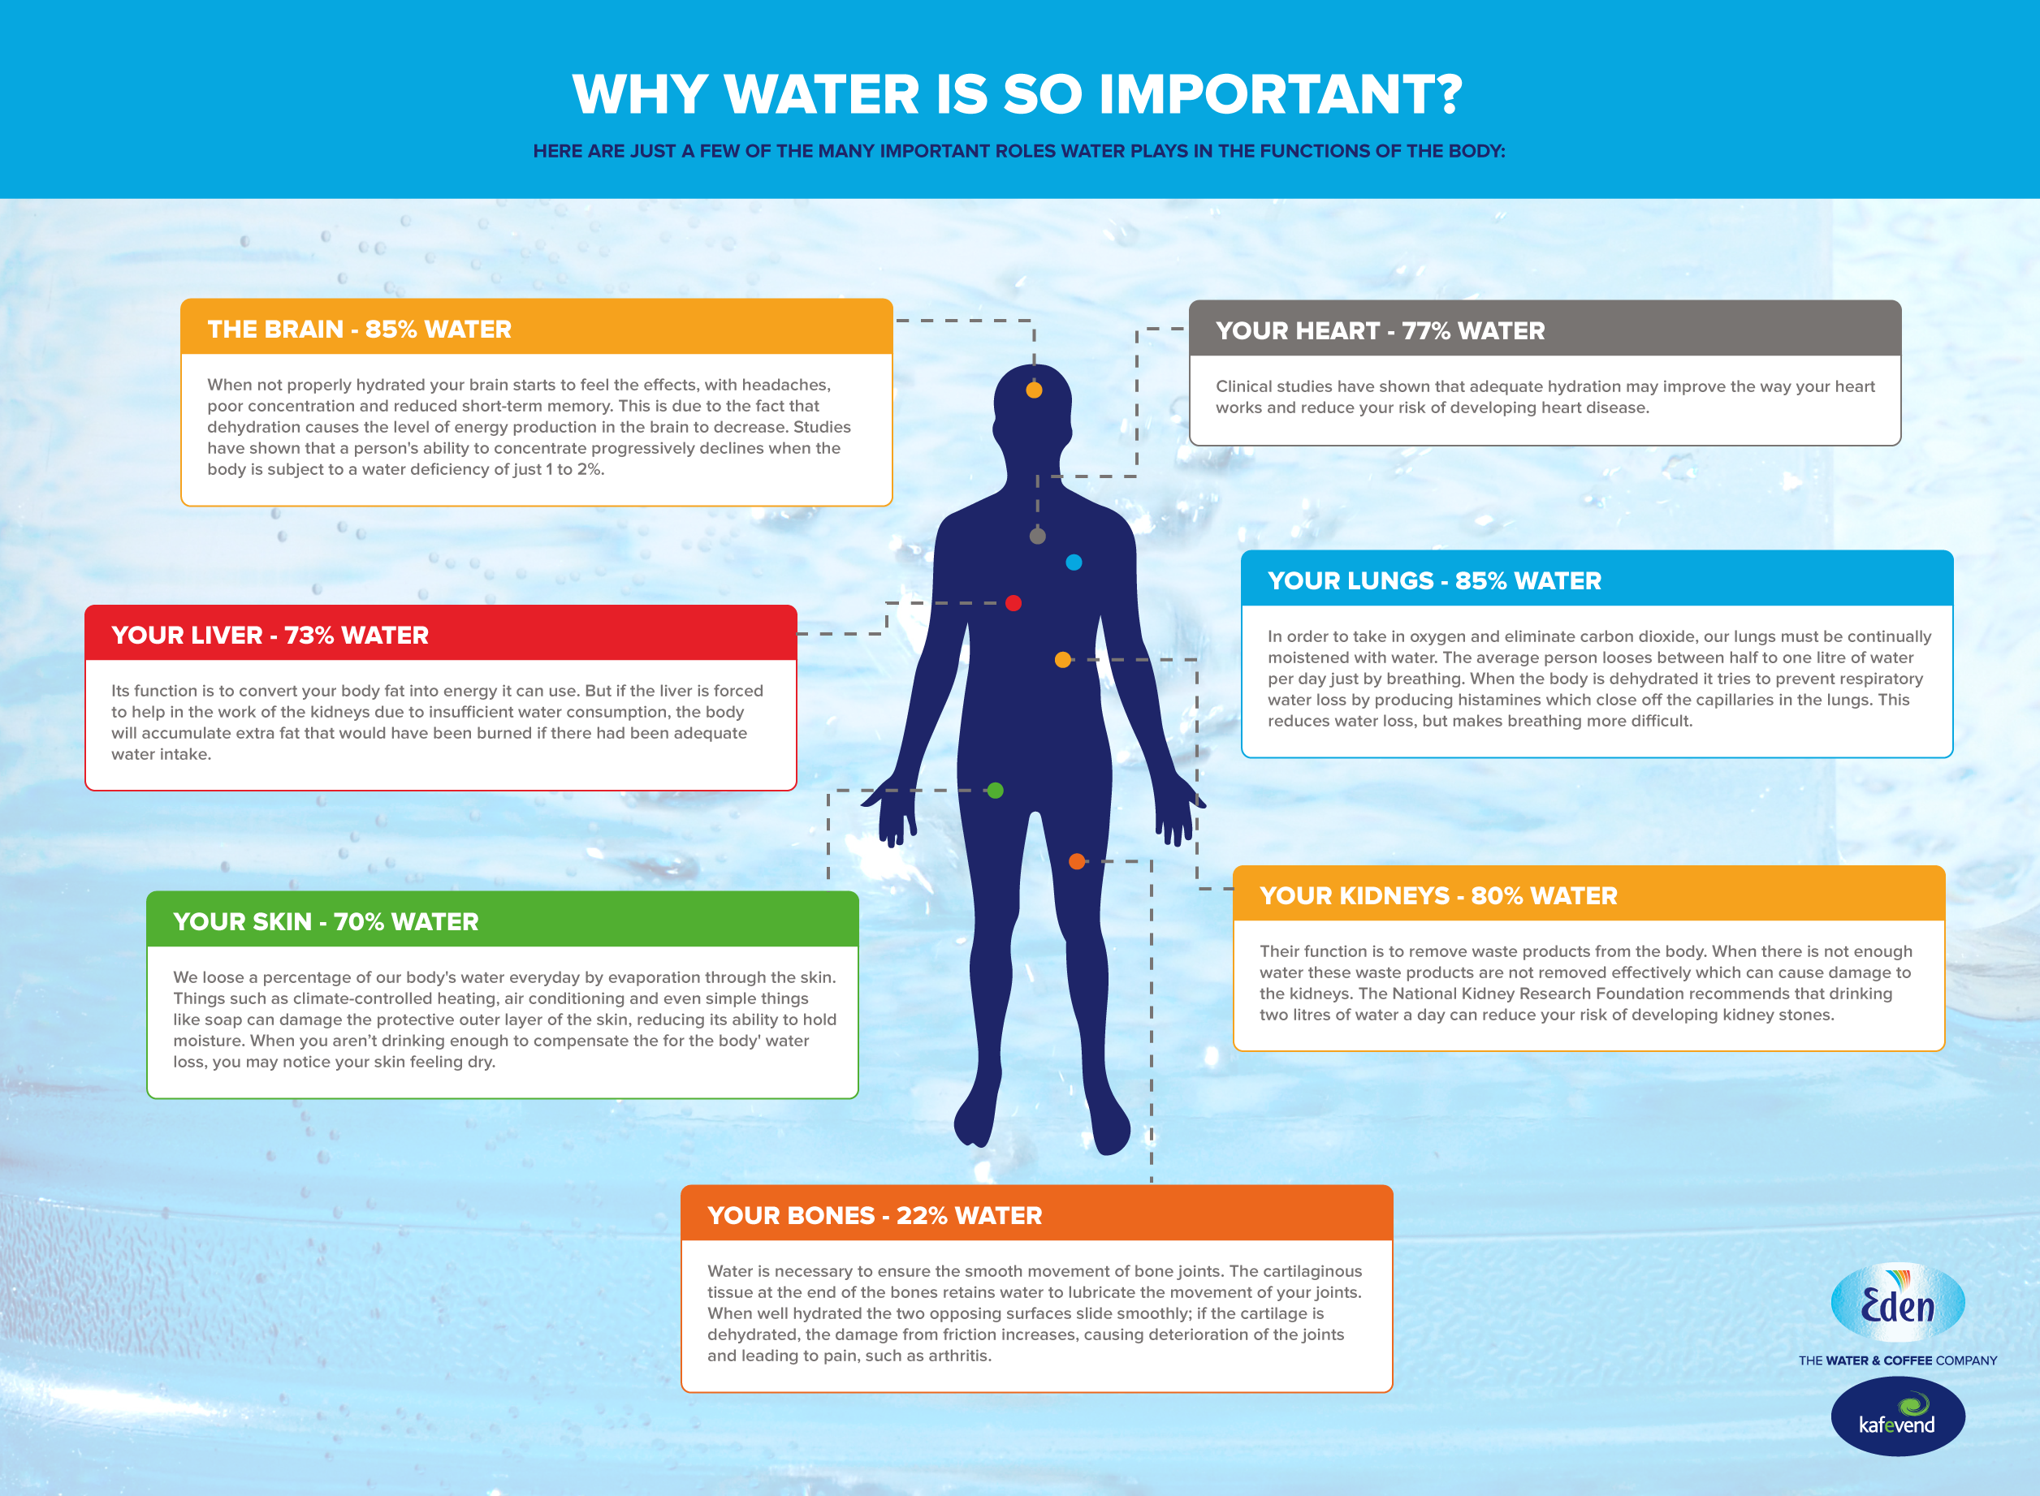

Slide 10
How many calories should I burn in a day?
The number of calories you should burn in a day largely depends on your personal health and fitness goals, as well as other factors like your age, sex, height, weight, and activity levels.
To lose weight :
To lose weight, you must be in a calorie deficit. This means you’re either eating fewer calories than your body needs, burning additional calories, or a combination of both.
For sustainable weight loss, an ideal calorie deficit will be around 10–20% fewer calories than your total daily energy expenditure (TDEE).
To maintain weight :
If you’re looking to maintain your weight, you’ll want to ensure your calorie intake matches your calorie expenditure.
To gain weight :
If you want to gain weight, you need to be in a calorie surplus. This means that you’re either eating more calories than your body needs, expending fewer calories, or a combination of both.

Slide 11
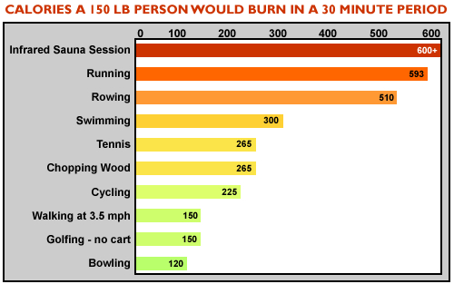

Slide 12
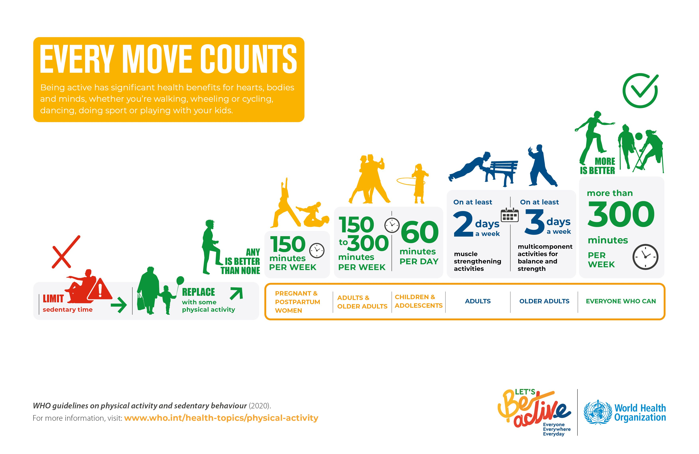

Slide 13
Project code
Created project by python using (oops) concept object oriented programing.
1.Create class health
2.Inside class create functions like:
1.bmi()
2.health_status()
3.body_bmr()
4.daily_req_calorie_level()
5.micro_and_macro()
6.water_intake()
7.calories_burn()
3.Execute the function (run the code)

Slide 14

THANK YOU!!!

